Slide 1
UML Class Diagram

Slide 2

UML Class

Slide 3
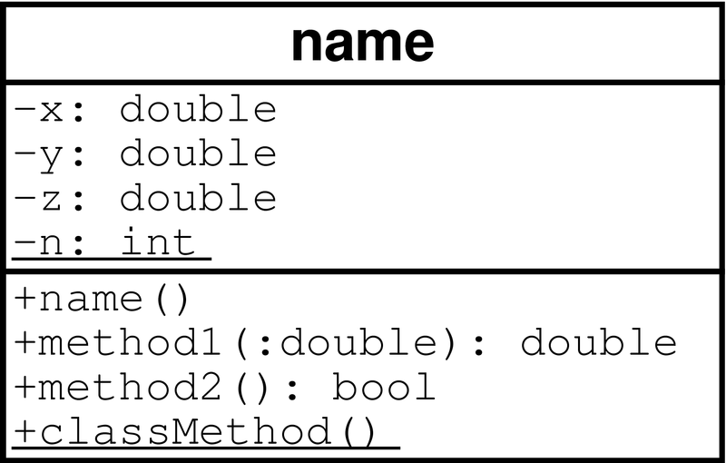
UML Class
Class name
Data members
Instance methods
Class method
Return types
Arguments

Slide 4
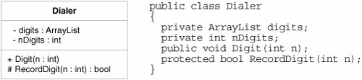
UML Class

Slide 5
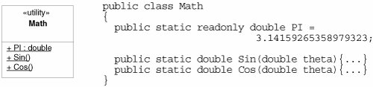
UML Static Class
Notes:
All the methods and variables of a «utility» class are static. Booch used to call these class utilities

Slide 6
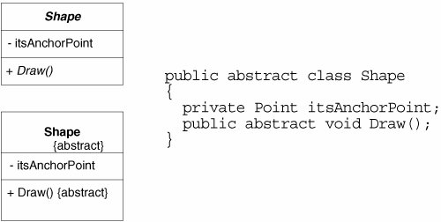
UML Abstract Class
Notes:
In UML, there are two ways to denote that a class or a method is abstract. You can write the name in italics, or you can use the {abstract} property.

Slide 7

UML Nested Class
Notes:
Nested classes are represented in UML with an association adorned with a crossed circle

Slide 8
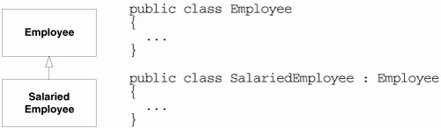
UML Inheritance

Slide 9
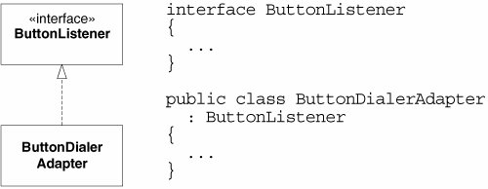
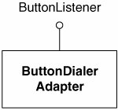
UML Interface

Slide 10



UML Association

Slide 11
Associations
Role name
Association name
instructor
StaffMember
Student
1..*
instructs
*
Role
Navigable
(uni-directional) association
Multiplicity
*
pre -
requisites
Courses
0..3
Reflexive association

Slide 12


UML Whole Part
Notes:
I don't find this to be a particularly useful definition. How often am I concerned about making sure that instances form a directed acyclic graph? Not very often. Therefore, I find this relationship useless in the kinds of diagrams I draw.

Slide 13
UML Associations
Person
Realization
Aggregation
Bi-directional Association
Customer
Rental Invoice
Invoice Detail
Rental Item
1..*
1
0..1
Composition
Simple
Uni-directional Association
Generalization
Printer Manager
DVD Movie
VHS Movie
Video Game
Checkout Screen
Dependency

Slide 14
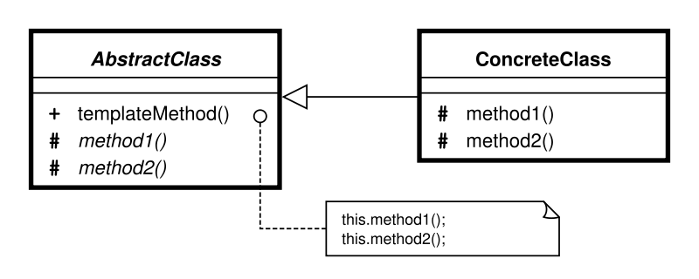
UML Comment

Slide 15
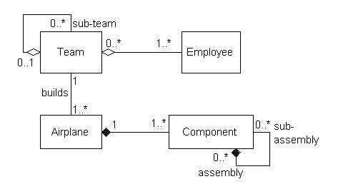
Example

Slide 16
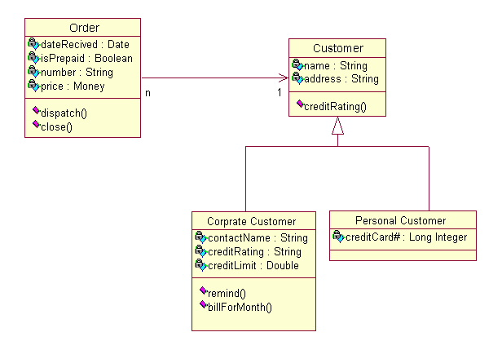
Example

Slide 17
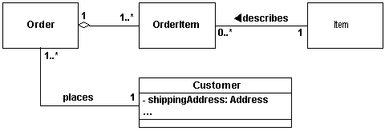
Example

Slide 18
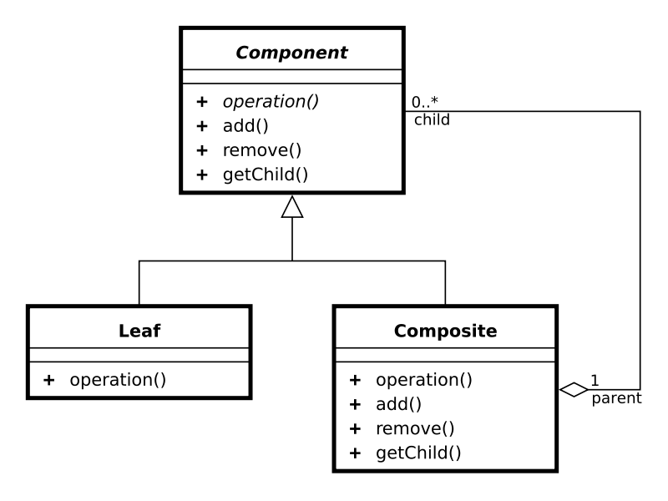
Example

Slide 19
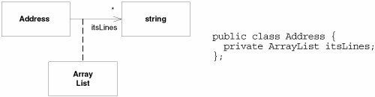
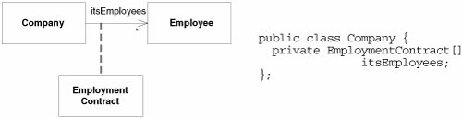
UML Association Class

Slide 20
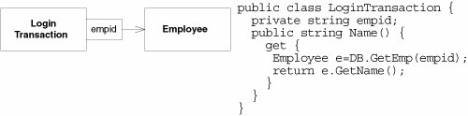
UML Association Qualifier
Notes:
Association qualifiers are used when the association is implemented through some kind of key or token instead of with a normal reference.

